Slide 1
AIML CA1
Tan Yu Hoe | P2026309
Diploma in Applied AI and Analytics | DAAA/FT/2A/04
School of Computing | Singapore Polytechnic
tanyh.20@ichat.sp.edu.sg
AIML | ST1511
CA1 Assignment

Slide 2
Part A: Mushroom Classification
Prediction Task
The prediction task is to create a machine learning model to predict a mushroom’s edibility, either edible or poisonous, based on the mushroom’s attributes.
Output Variable
The output variable is a two-class label - edible or poisonous. Edible (e) is defined the mushroom would cause no hard when consumed; whereas poisonous (p) refers to the mushroom will cause harmful effects when eaten.

Slide 3
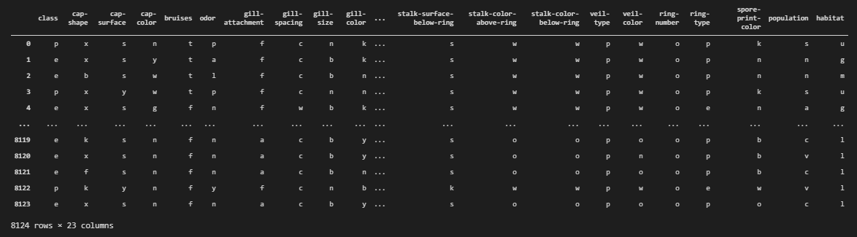
The Data
This data set includes descriptions corresponding to 23 species of gilled mushrooms. Each species is identified to be either edible or poisonous.
Number of Instance: 8,124
Number of Attributes: 22 (all nominal valued)
Missing values are denoted as ‘?’

Slide 4
Attribute Information
1. cap-shape: bell=b,conical=c,convex=x,flat=f, knobbed=k,sunken=s 2. cap-surface: fibrous=f,grooves=g,scaly=y,smooth=s 3. cap-color: brown=n,buff=b,cinnamon=c,gray=g,green=r, pink=p,purple=u,red=e,white=w,yellow=y 4. bruises?: bruises=t,no=f 5. odor: almond=a,anise=l,creosote=c,fishy=y,foul=f, musty=m,none=n,pungent=p,spicy=s 6. gill-attachment: attached=a,descending=d,free=f,notched=n 7. gill-spacing: close=c,crowded=w,distant=d 8. gill-size: broad=b,narrow=n 9. gill-color: black=k,brown=n,buff=b,chocolate=h,gray=g, green=r,orange=o,pink=p,purple=u,red=e, white=w,yellow=y 10. stalk-shape: enlarging=e,tapering=t 11. stalk-root: bulbous=b,club=c,cup=u,equal=e, rhizomorphs=z,rooted=r,missing=? 12. stalk-surface-above-ring: fibrous=f,scaly=y,silky=k,smooth=s 13. stalk-surface-below-ring: fibrous=f,scaly=y,silky=k,smooth=s 14. stalk-color-above-ring: brown=n,buff=b,cinnamon=c,gray=g,orange=o, pink=p,red=e,white=w,yellow=y 15. stalk-color-below-ring: brown=n,buff=b,cinnamon=c,gray=g,orange=o, pink=p,red=e,white=w,yellow=y 16. veil-type: partial=p,universal=u 17. veil-color: brown=n,orange=o,white=w,yellow=y 18. ring-number: none=n,one=o,two=t 19. ring-type: cobwebby=c,evanescent=e,flaring=f,large=l, none=n,pendant=p,sheathing=s,zone=z 20. spore-print-color: black=k,brown=n,buff=b,chocolate=h,green=r, orange=o,purple=u,white=w,yellow=y 21. population: abundant=a,clustered=c,numerous=n, scattered=s,several=v,solitary=y 22. habitat: grasses=g,leaves=l,meadows=m,paths=p, urban=u,waste=w,woods=d
Notes:
Copied from metadata

Slide 5

Exploratory Data Analysis
Topics I want to cover:
Data Profile
Warnings
Feature Selection
I have hosted a copy of my data profile on GitHub so feel free to scan the QR or access the link below.
URL: https://lekekbot.github.io/mushroom-profile/
Credits: this is not my GitHub account, special thanks to Bryan from DIT
Scan Here!

Slide 6
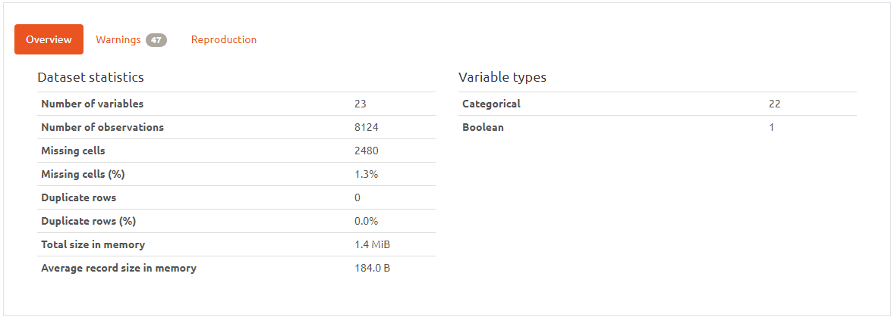
Data Profile
Notes:
I’ve used a library called Pandas-Profiling to generate a report
23 columns (22 attributes, 1 target variable)
About 2480 samples contains missing data
Every column are categorical data – meta data states every attributes are nominally valued
Data is 1.4 Milli Byte, relatively small
Message to self: “I’m pretty sure you guys have already know or seen the data by now, so I will not be touching on this part since there are other stuff that might be more interesting”

Slide 7
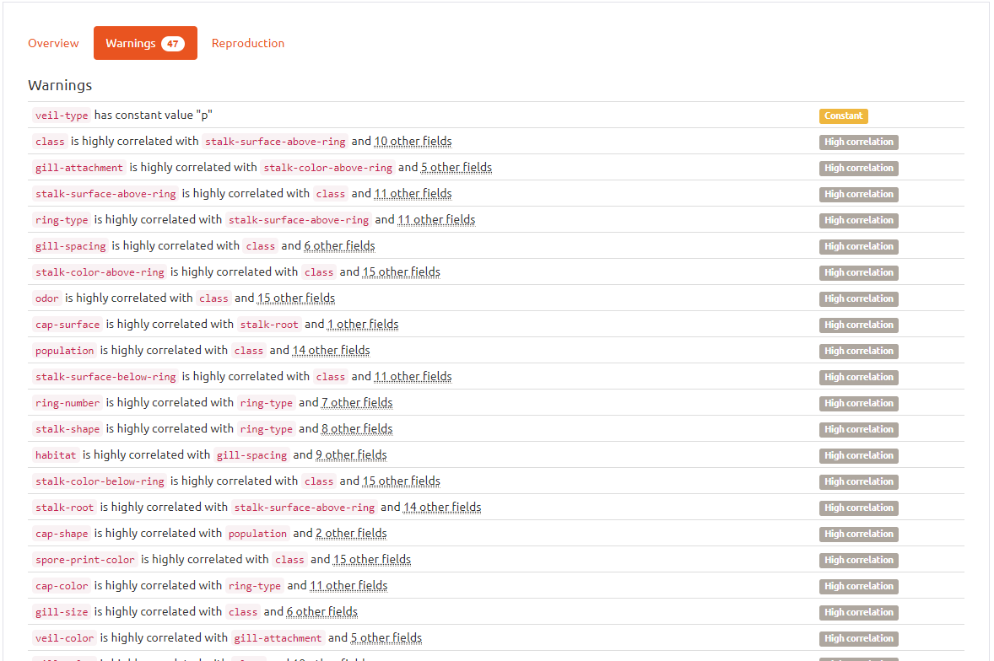
Warnings
Profile Reports shows 47 Warnings
Key points:
All of the columns are categorical data
- requires encoding
“veil-type” contains only one class
- drop column since there is no variance
“stalk-root” has 30.5% missing data
- either impute or drop the entire column
high correlation between features
- have to check for multicollinearity
Notes:
I’ve used a library called Pandas-Profiling to generate a report
There are about 47 warnings generated, but don’t worry I will be explaining

Slide 8
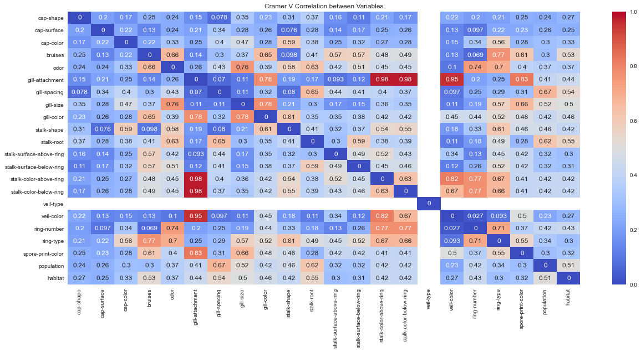
Cramer's V – Multicollinearity Feature Selection
Notes:
What are we looking for? High correlation/association between mushroom attributes
We found two very strong cluster

Slide 9
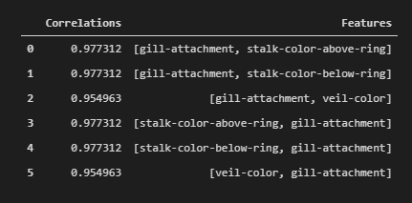
Cramer's V – Multicollinearity Feature Selection
Key Points to take down:
“gill-attachment” has very high correlation with other attributes, where V > 0.9
these attributes are color-related attributes
Action Plan
drop column as it might reduce statistical significance on other attributes

Slide 10
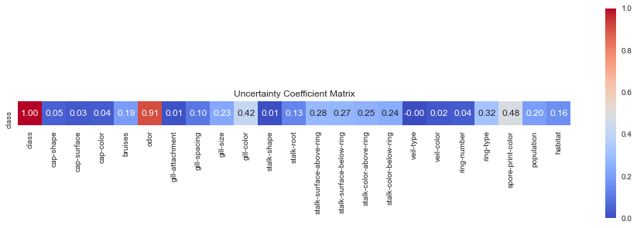
Theil’s U – Univariate Feature Selection
Notes:
Previously, we talked about finding very high correlation between attributes, now we are finding very low correlation between attributes and the target variable.
I have highlighted with a star for those attributes with very low correlation (U statistics < 0.05).

Slide 11
Theil’s U – Univariate Feature Selection
Key Points to take down:
These columns have low correlation with edibility, where U < 0.05
cap-shape, cap-surface, cap-color, gill-attachment, stalk-shape, veil-type, veil-color, ring-number
Action Plan
Drop all these columns show below

Slide 12
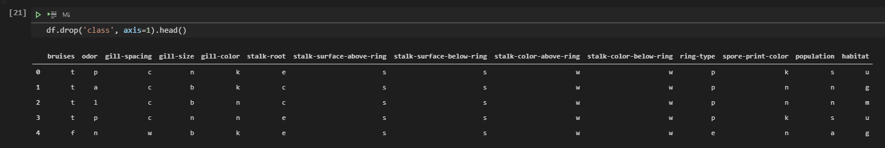
Displaying Features
After dropping many columns, I think it is safe to say we can proceed on to feature engineering.

Slide 13
Feature Engineering / Preprocessing
For Feature Engineering, I will be covering these technique applied to this dataset:
Data Partition
Imputation
Categorical Encoding
Nothing fancy to do on this dataset :/

Slide 14
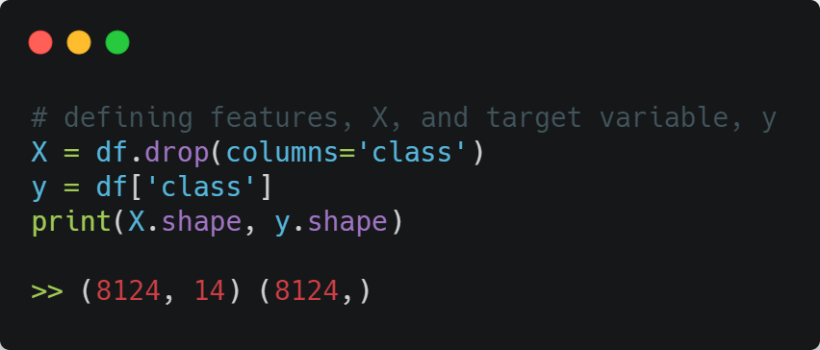
Features and Target variable

Slide 15
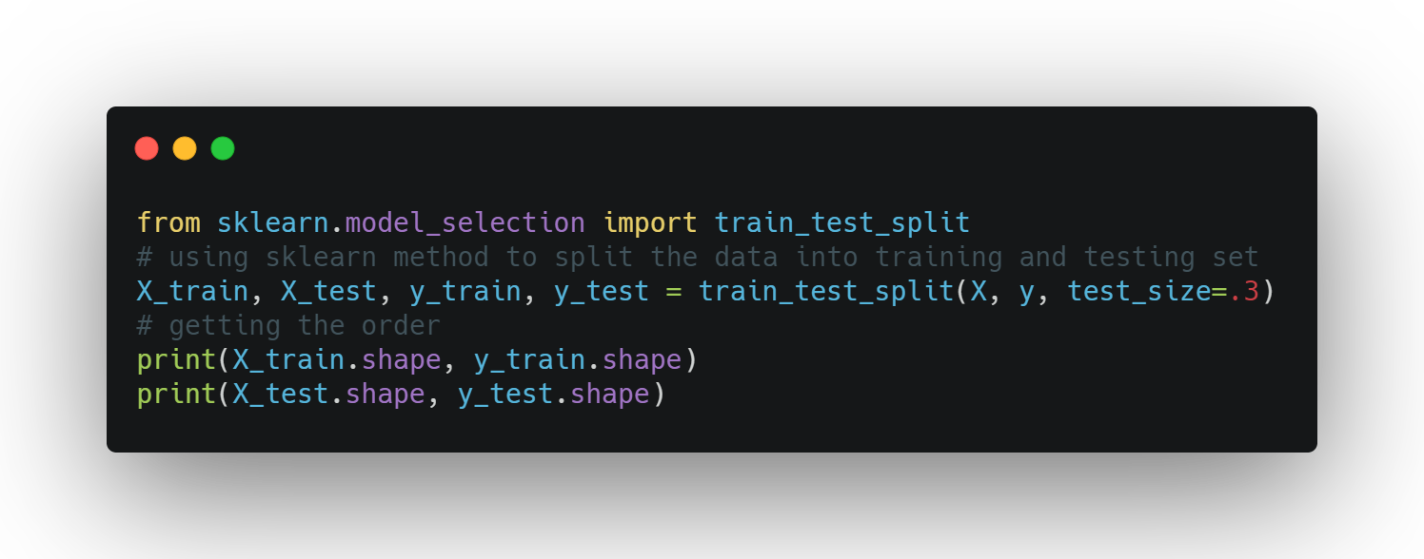
Data Partition
Notes:
I will be first partitioning the data into training (70%) and testing set (30%). You may ask why 7:3 ratio, the reason being this dataset is particularly small (8124 observations), I personally think it is necessary to have more data allocated to the testing set to evaluate the model better.

Slide 16
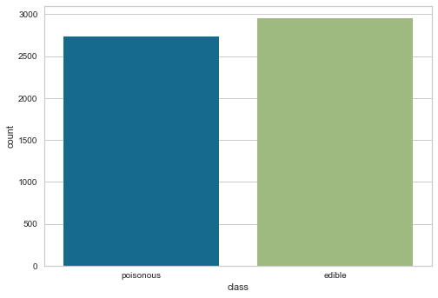
Data Partition
The two class count are quite close to each other, so no class balancing is needed.

Slide 17
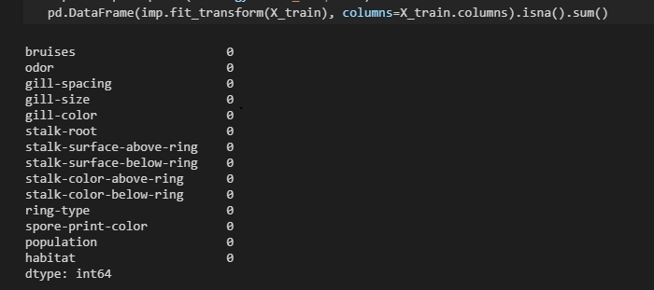
Imputation
I will be using `SimpleImputer` from `sklearn.impute` to impute missing values with the mode value.

Slide 18
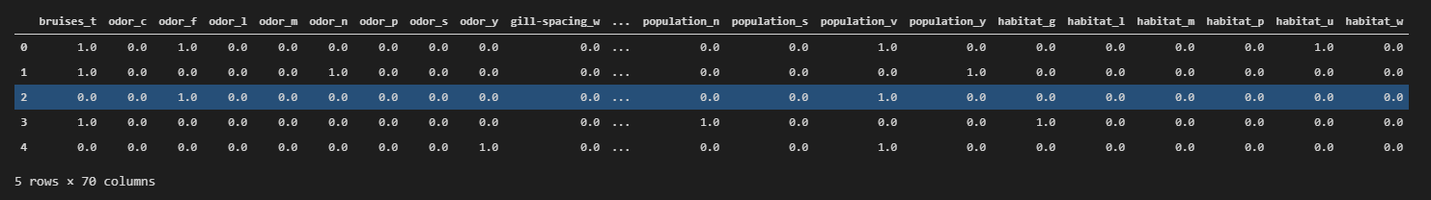
One Hot Encoding
Probably the most magical thing we learnt during Week 2.
Why One Hot Encoding?
The metadata states that all variables are nominally valued, as such we have to assume all variables to be nominal data. Since there is no order, I have to use sklearn.preprocessing.OneHotEncoder method to encode the data.

Slide 19
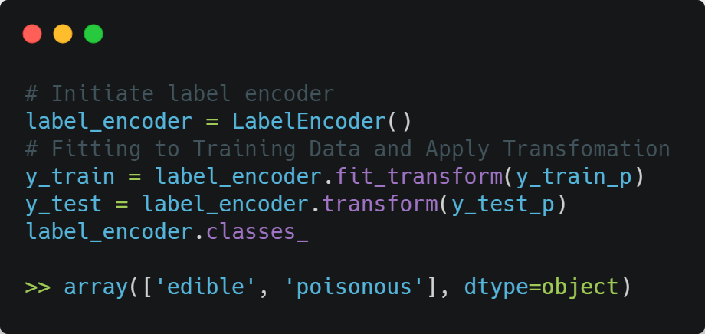
Label Encoder
Label encoding the target variable, 0 = ‘edible’, 1 = ‘poisonous’.

Slide 20
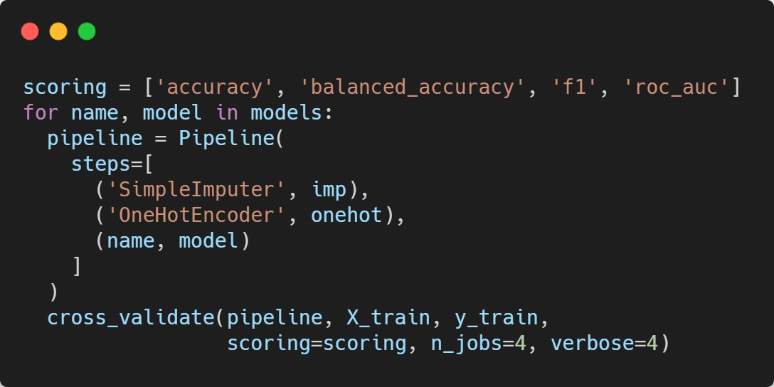
Model Selection
My plan for model selection is to fit through a collection of models at default hyperparameters with a pipeline. Then I will make my decision based on the K-Fold Cross Validation, cv = 5, mean accuracy score.

Slide 21
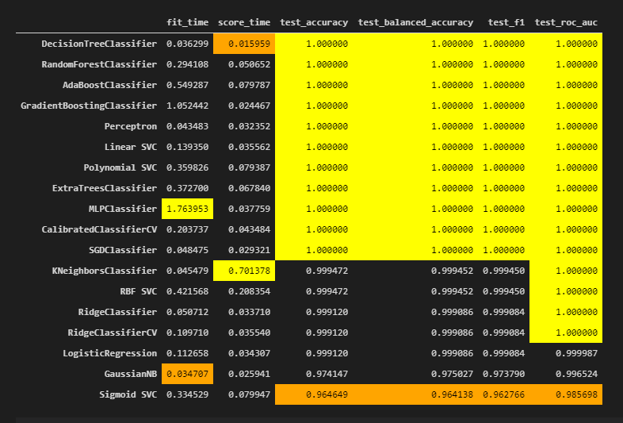
Model Selection
Most of the models I have preselected has 1.0 accuracy.
Since there is a dilemma in choosing learning algorithms, I decided to go with the simplest model with the best explain ability, Decision Tree Classifier.

Slide 22
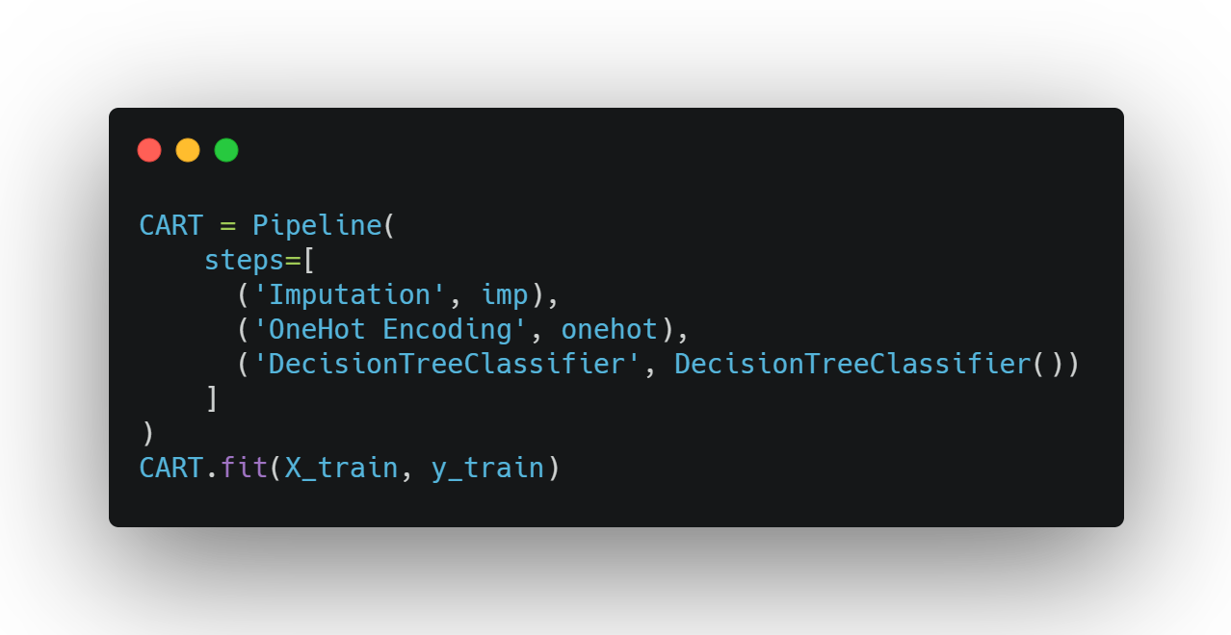
Model Selection
Notes:
I fitted the model through a pipeline, now I want to benchmark my model against a stupid baseline, Dummy Classifier.

Slide 23
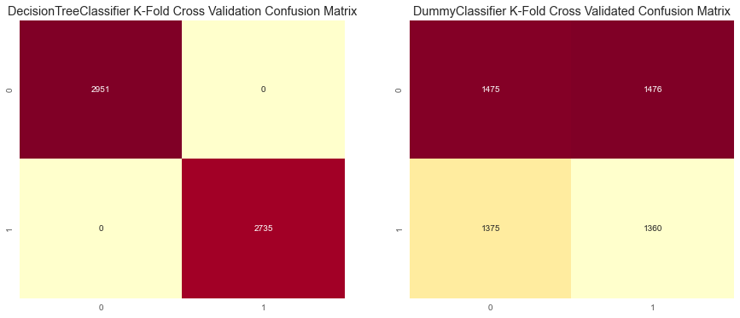
Comparing to Baseline – Confusion Matrix
Notes:
DecisionTreeClassifier is performing very well with k-fold cross validation, with no false predictions
we can see the predictions made by the baseline are all over the place

Slide 24
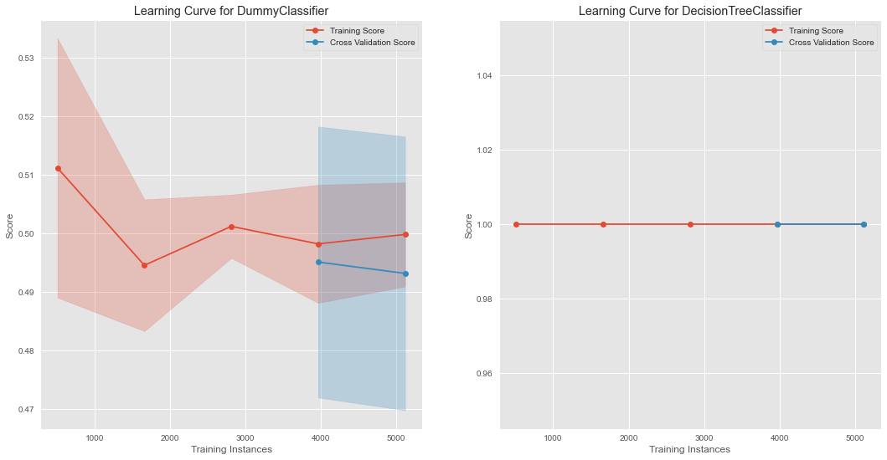
Comparing to Baseline – Learning Curve
Notes:
Dummy Classifier looks like it is underfitting with its very low accuracy score
Perfect fit for decision tree

Slide 25
Hyperparameter Tuning
Since the dataset is relatively small and this is a two-class classification prediction task, we can afford to use GridSearchCV to perform an exhaustive search for the best hyperparameters. Since we are using DecisionTreeClassifier, I will be listing down the parameters that I will be tuning.
criterion - measure the quality of the split
max_depth - maximum depth of the tree, basically how big can the tree grow
max_leaf_nodes - stopping criteria for number of leaves

Slide 26
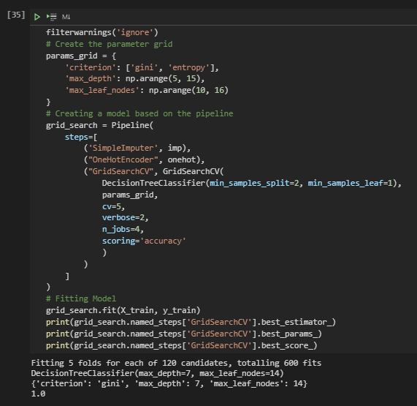
Hyperparameter Tuning

Slide 27
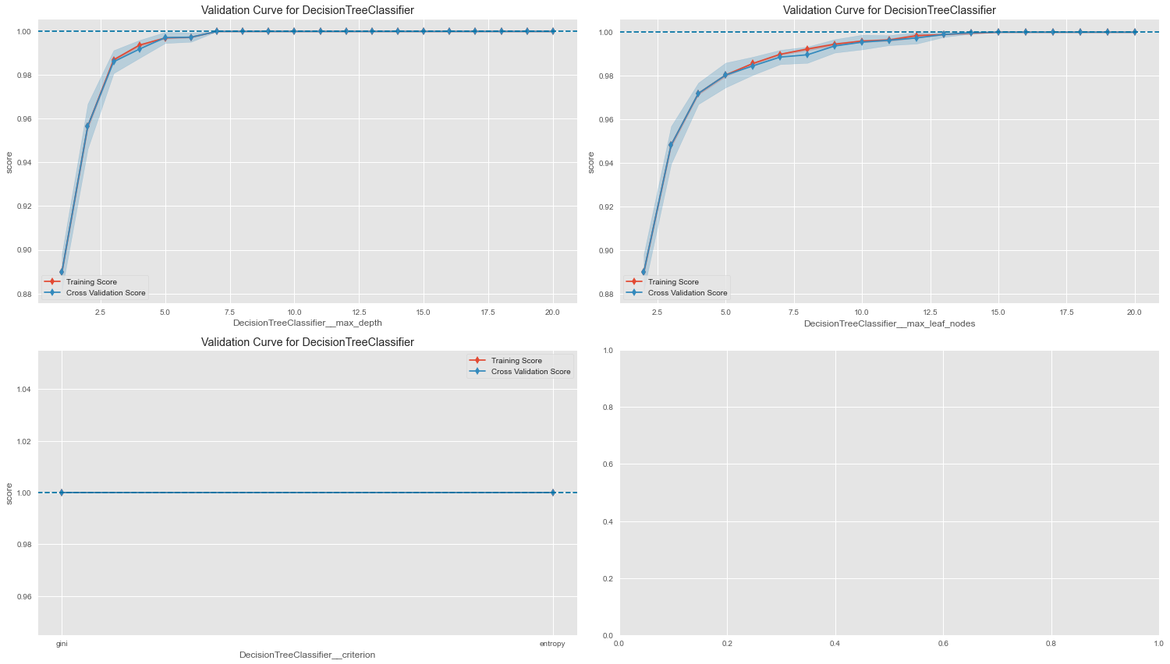
Notes:
max_depth: we can see from 7 onwards the accuracy score reaches its peak and maintain its accuracy
max_leaf_node: we can see that from 14 onwards the accuracy score reaches its peak and maintain its accuracy
criterion: gini is better than entropy in terms of accuracy
max_feature: very varying results based on the number of features, there are two instances where accuracy score peaks, 10 and 16

Slide 28
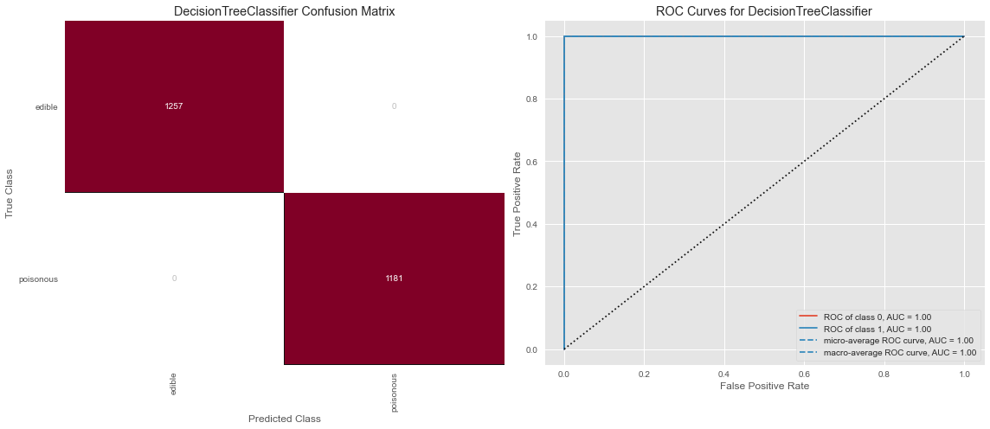
Model Evaluation
Notes:
Model makes no error

Slide 29
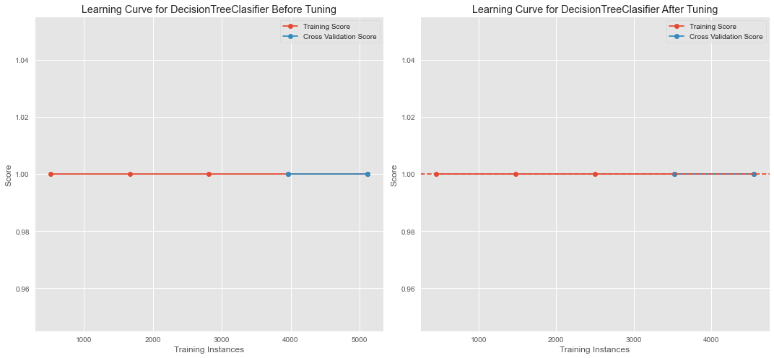
Model Evaluation – Learning Curve
Notes:
smaller gap between training score and cross validation score compared to the previous learning curve shows that the model is overfitting less
around 2200 training instances, the model is underfitting by abit
overall, the model is a good fit

Slide 30
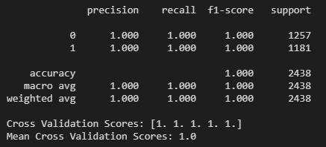
Model Evaluation

Slide 31
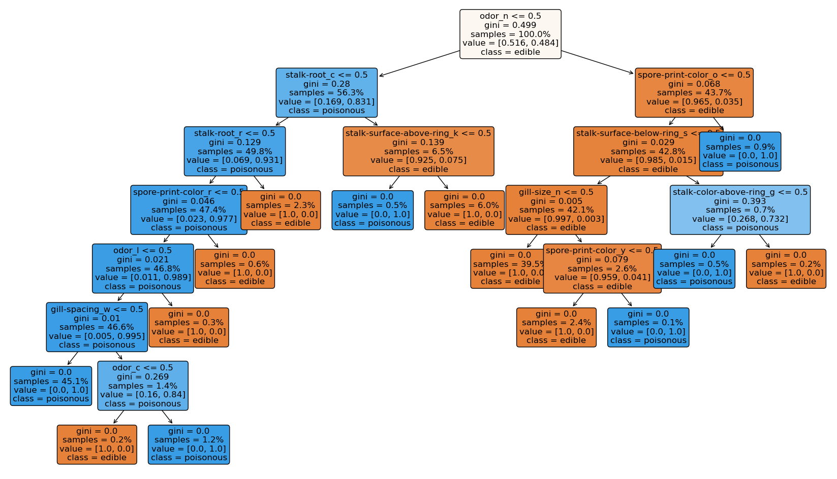
Notes:
at the root node: odor_none makes the biggest decision in the tree, if the the there is no odor (odor_n = 1) the mushroom is likely to be edible, else poisonous
bruises_t = 0, makes the second biggest decision, about 40% of the test data ends up in the leaf node
bruises_t=0, mushroom sample does not have any bruises high likely mushroom sample is poisonous

Slide 32
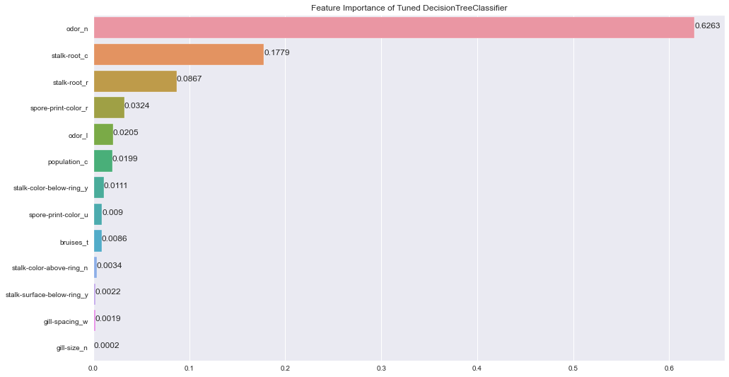
Model Evaluation – Feature Importance
Notes:
Is it possible to say something about which features the model considers important?
These features are relevant in determining the edibility of a mushroom
'odor_n', 'bruises_t', 'odor_f', 'stalk-root_e', 'habitat_m', 'stalk-surface-below-ring_y', 'habitat_g', 'gill-color_g', 'gill-color_r', 'stalk-color-above-ring_y', 'gill-spacing_w', 'population_v', 'gill-size_n'
Most significant feature in determining a mushroom sample edibility is odor_n

Slide 33
Forenote
I think the most defining factor to checking a mushroom edibility is their odor and their stalk roots.
One Area I would improve is perhaps implement better feature selection techniques for practical machine learning and better deployment flexibility.

Slide 34
Part B: Kings County House Price Prediction
Prediction Task
The prediction task is to create a predictive regression model to predict the house prices based of the house sales’ attribute given.
Output Variable
The output variable is `price`, refering to the price of the house sale. The variable is numerical-continuous variable, as such the prediction task requires a regression model.

Slide 35
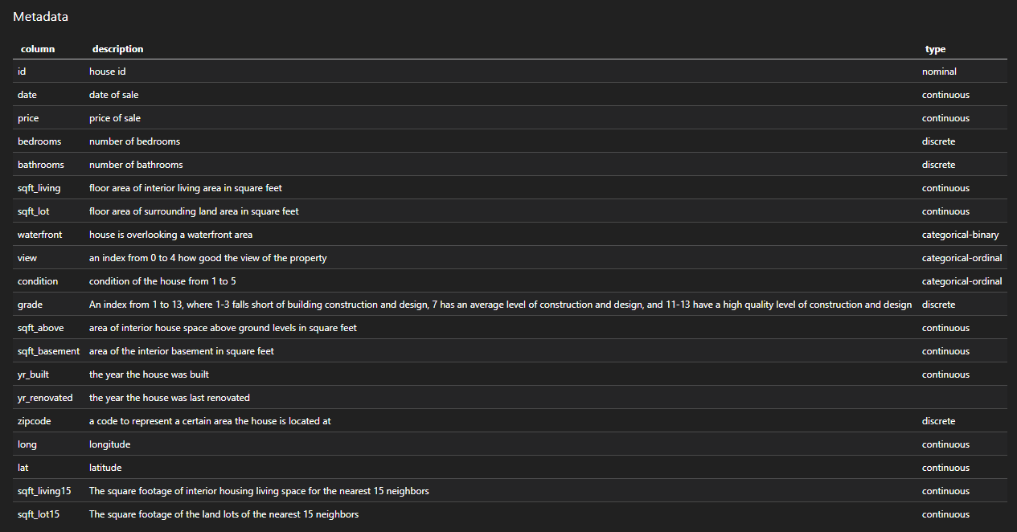
The Data

Slide 36

Exploratory Data Analysis
Topics I want to cover:
Data Profile
Warnings
Analysis on Target Variable and Attributes
Feature Selection
I have hosted a copy of my data profile on GitHub so feel free to scan the QR or access the link below.
URL: https://lekekbot.github.io/yh-just-why/
Credits: this is not my GitHub account, special thanks to Bryan from DIT
Scan Here!

Slide 37
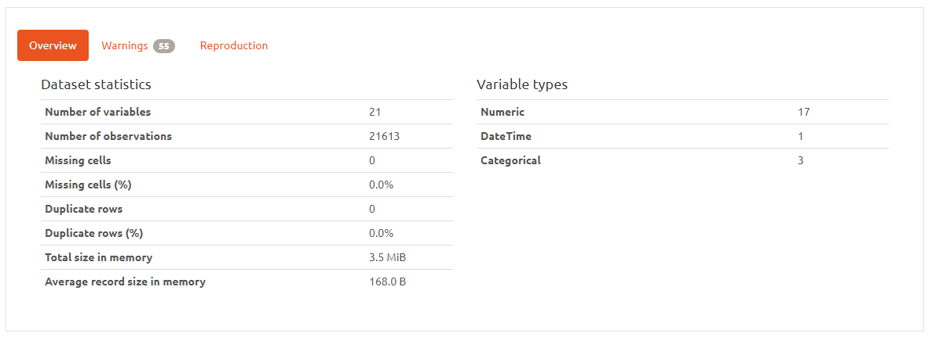
Data Profile

Slide 38
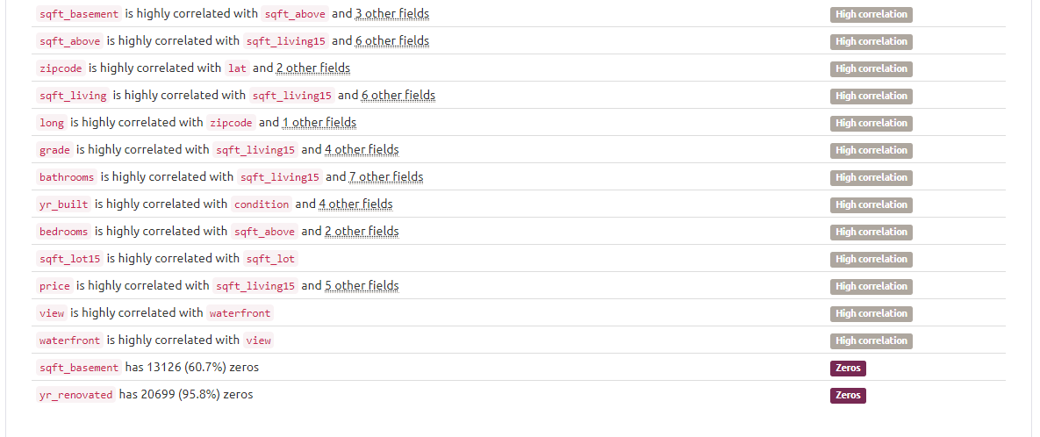
Warnings
Profile Reports shows 55 Warnings
Key points:
high correlation between features
- have to check for multicollinearity
‘sqft_basement’ has 60.7% zeros
‘yr_renovated’ has 95.8% zeros
Notes:
I’ve used a library called Pandas-Profiling to generate a report
There are about 47 warnings generated, but don’t worry I will be explaining

Slide 39
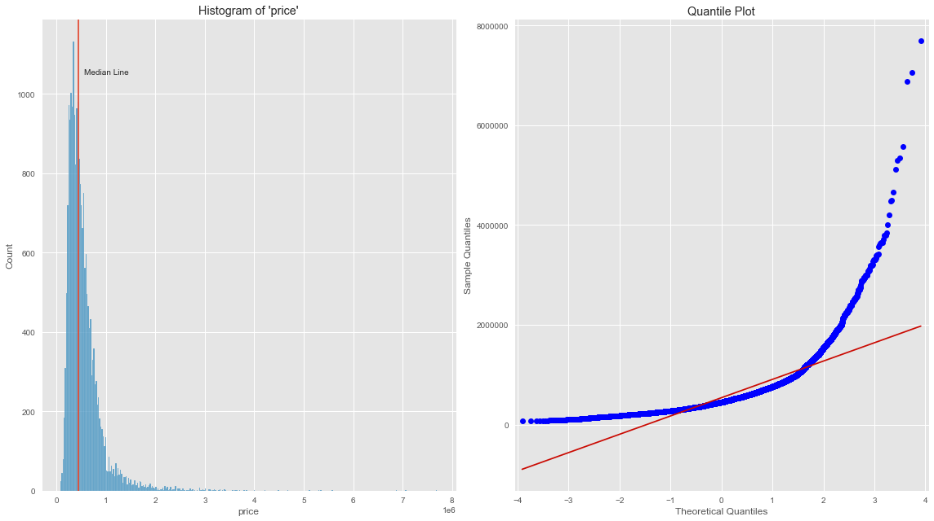
Analysis on Target Variable
Notes:
Histogram does not follow a gaussian distribution, with a right tail extending out
Quantile plot shows positive skewness
price likely need to undergo log/power transformation to get a gaussian distribution

Slide 40
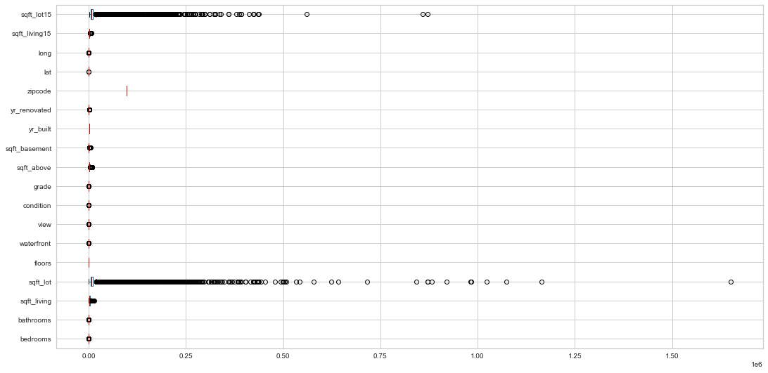
Analysis on Attributes
Notes:
almost all columns listed in the histogram does not follow a normal distribution

Slide 41
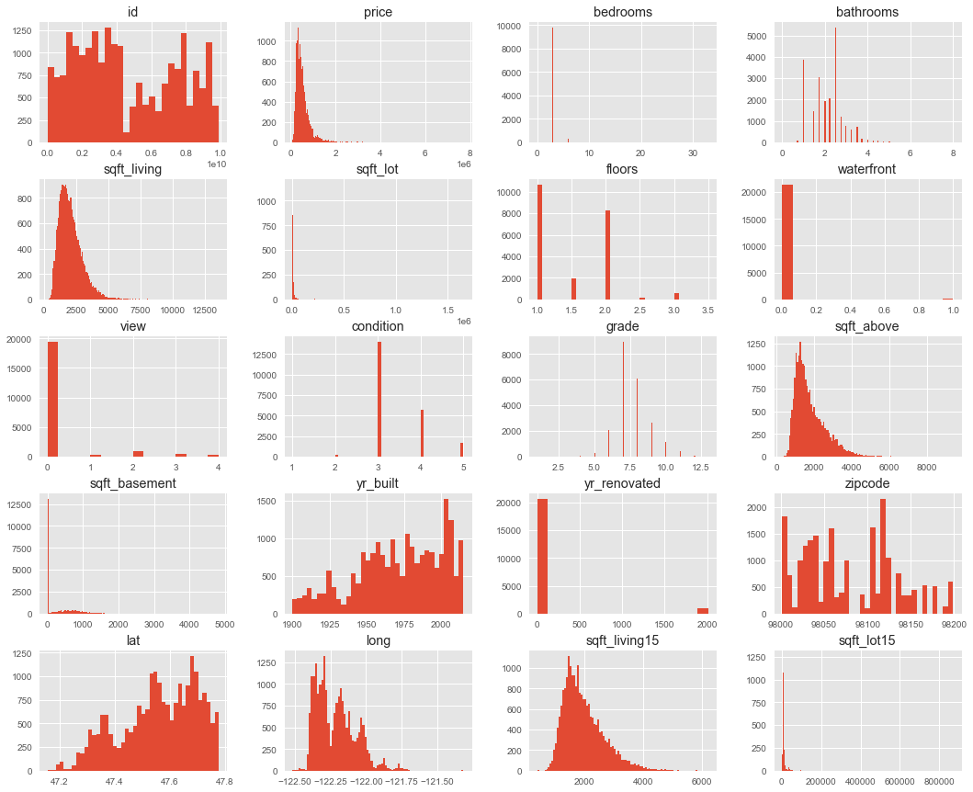
Notes:
almost all columns listed in the histogram does not follow a normal distribution

Slide 42
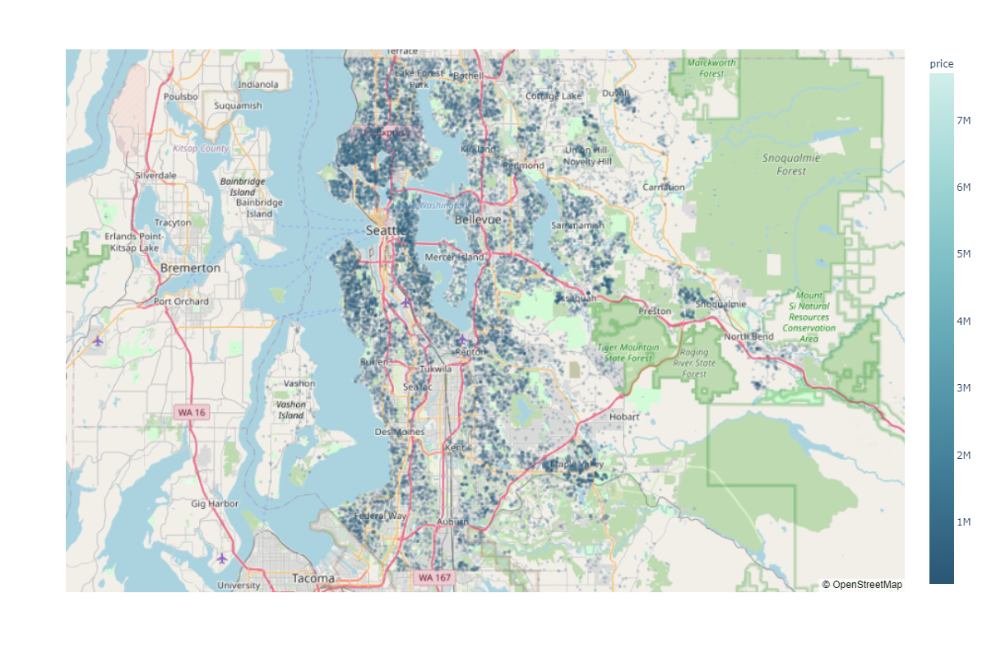

Slide 43
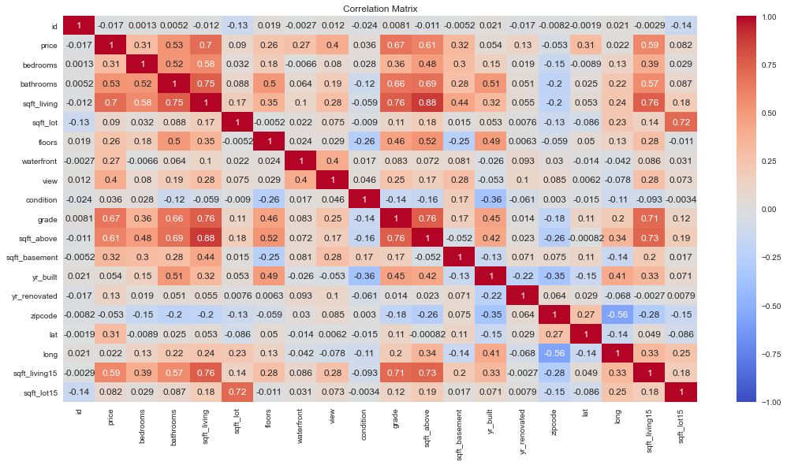
Feature Selection – Pearson Correlation Matrix

Slide 44
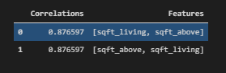
Feature Selection – Multicollinearity
Key Points
sqft_living and sqft_above has high collinearity
Remove sqft_above as sqft_living has a high correlation with price

Slide 45
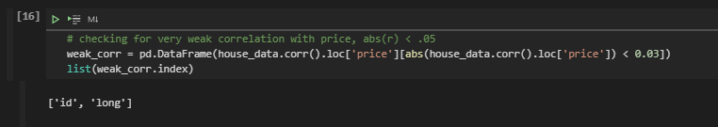
Feature Selection – Weak Correlation with price
id and long has very weak correlation with price
Dropping both columns are they are insignificant to predicting price

Slide 46
Feature Engineering / Preprocessing
For Feature Engineering, I will be covering these technique applied to this dataset:
House Age
Data Partition
Log Transformation
Normalisation
Target Transformation

Slide 47
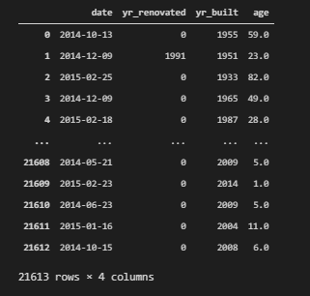
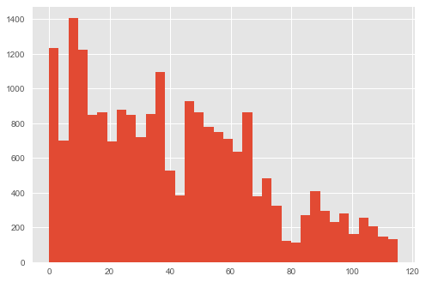
House Age
Age referring to the time difference between date and yr_renovated/yr_built

Slide 48
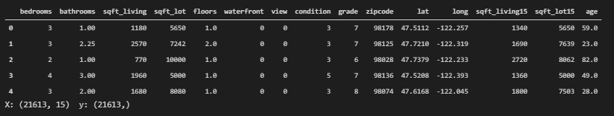
Data Partition
I dropped 6 columns in total so I will be using these columns below as features.

Slide 49
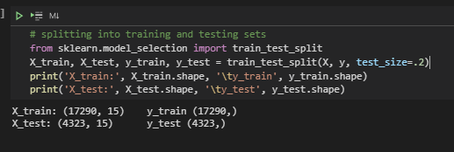
Data Partition

Slide 50
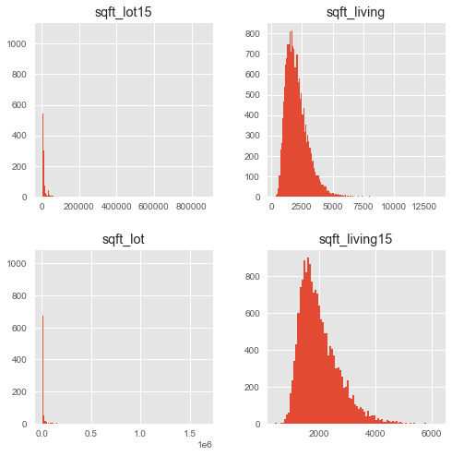
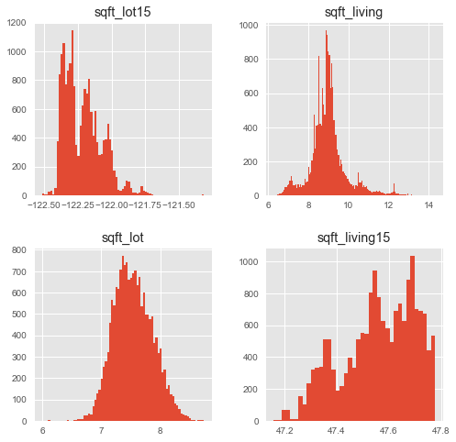
Log Transformation
Notes:
Left – before applying log transformation
Right – apply log transformation

Slide 51
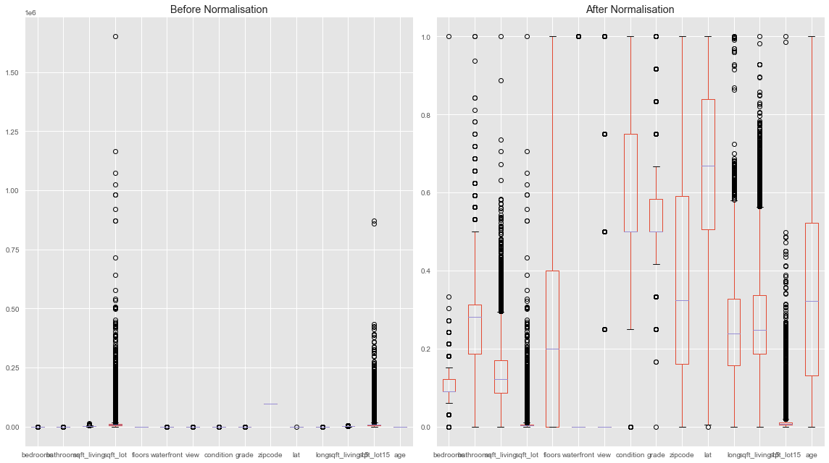
Normalization – Min Max Scaling
Notes:
Left – before applying min max scaling
Right – after applying min max scaling

Slide 52
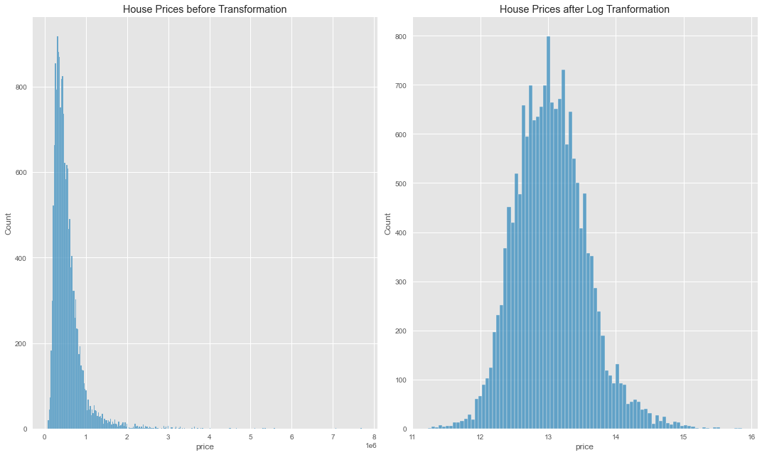
Target Transformation
Notes:
Left – before applying min max scaling
Right – after applying min max scaling

Slide 53
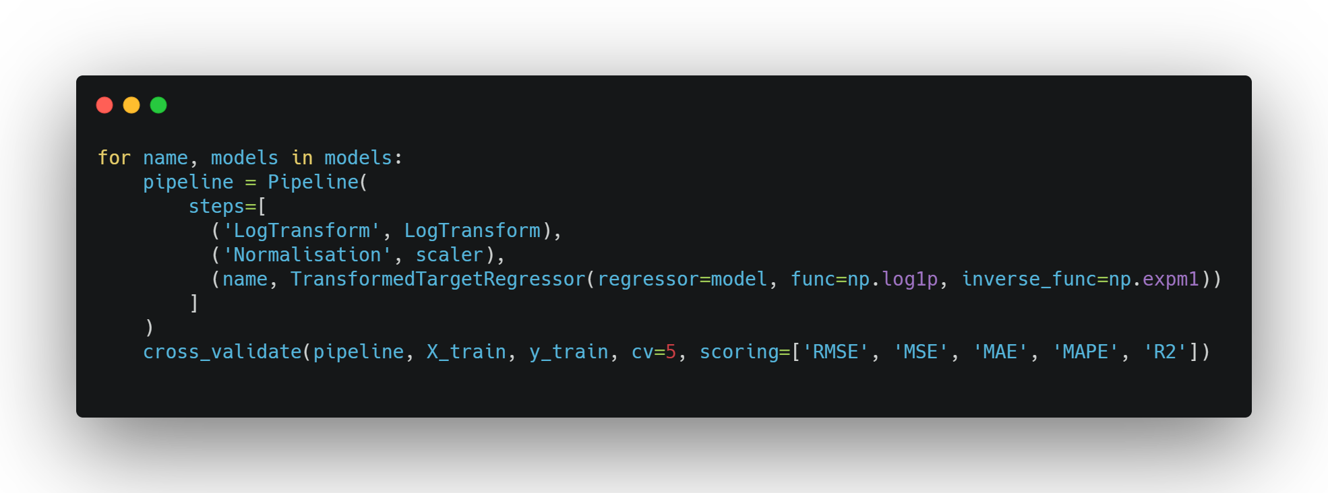
Model Selection
Notes:
Overall flow of my pipeline

Slide 54
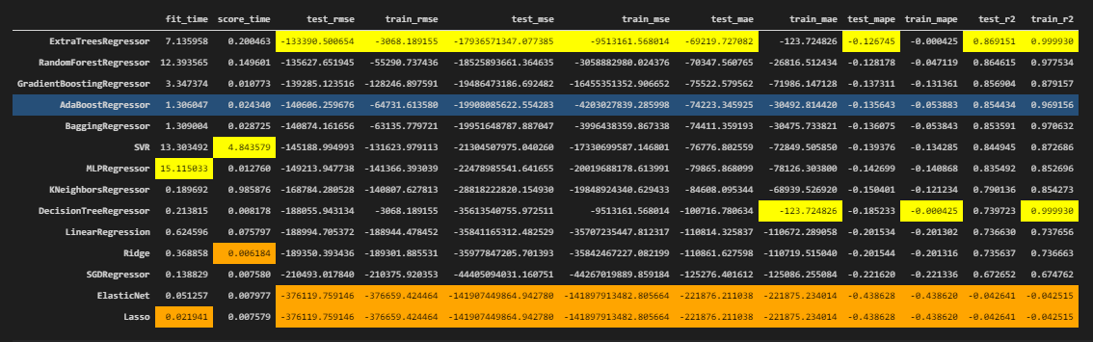
Model Selection
Notes:
-bagging regressors performs the best
-linear regression with and without regularization performs very badly
-However, there is a trade-off between accuracy and training time. Here, ExtraTrees and RandomForest have exceptional high fitting timing. Since I do not want to waste too much time training, I would go for boosting algorithms since they are doing well and have lower training time compared to bagging algorithms. Between Adaptive Boosting and Gradient Boosting, I would go for Gradient Boosting since it is more flexible in nature to the data it trains with.
-another reason for gradient boosting is gradient boosting grows sequentially, whereas baggin grows in parallel, as such I was to go for boosting algorithm as it has more upscaling potential

Slide 55
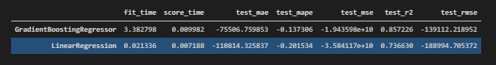
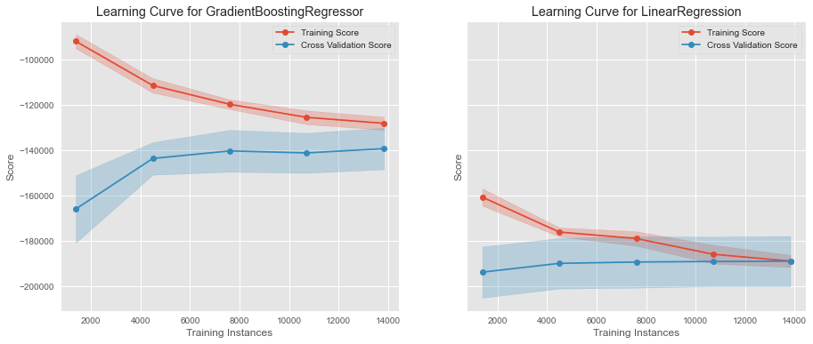
Model Selection – Comparing with Baseline
Notes:
GradientBoostingRegressor has a smaller errors compared to LinearRegression, based on RMSE by 40K. Gradient Boosting also has a higher R2 than LinearRegression, meaning GradientBoosting fits better.
For Gradient Boosting, we can see a gap, variance, between training score and cross validation score
Some overfitting
For Linear Regression, we can see the training score matches the validation score
underfitting

Slide 56
Hyperparameter Tuning
Earlier this year, sklearn 0.24 update came with HalvingGridSearchCV, a new way to do Hyperparameter Tuning. HalvingGridSearchCV works by giving every combination a small number of resources and see how well it fare, those who've did well will go through the next iteration. Online articles have shown that HalvingGridSearchCV is apparently 11 times faster than GridSearchCV. As such, I will be using this method to run Hyperparameter Tuning.
Hyperparameters to be tuned:
n_estimators - how many trees we want in the model
max_depth - how large each tree should be, generally for gradient boosting we want to keep this Hyperparameter low
learning_rate - how fast should each tree learn, generally there is a trade off between learning rate and n_estimators
subsample - percentage of learners used for fitting, used to reduce variance (overfitting)

Slide 57
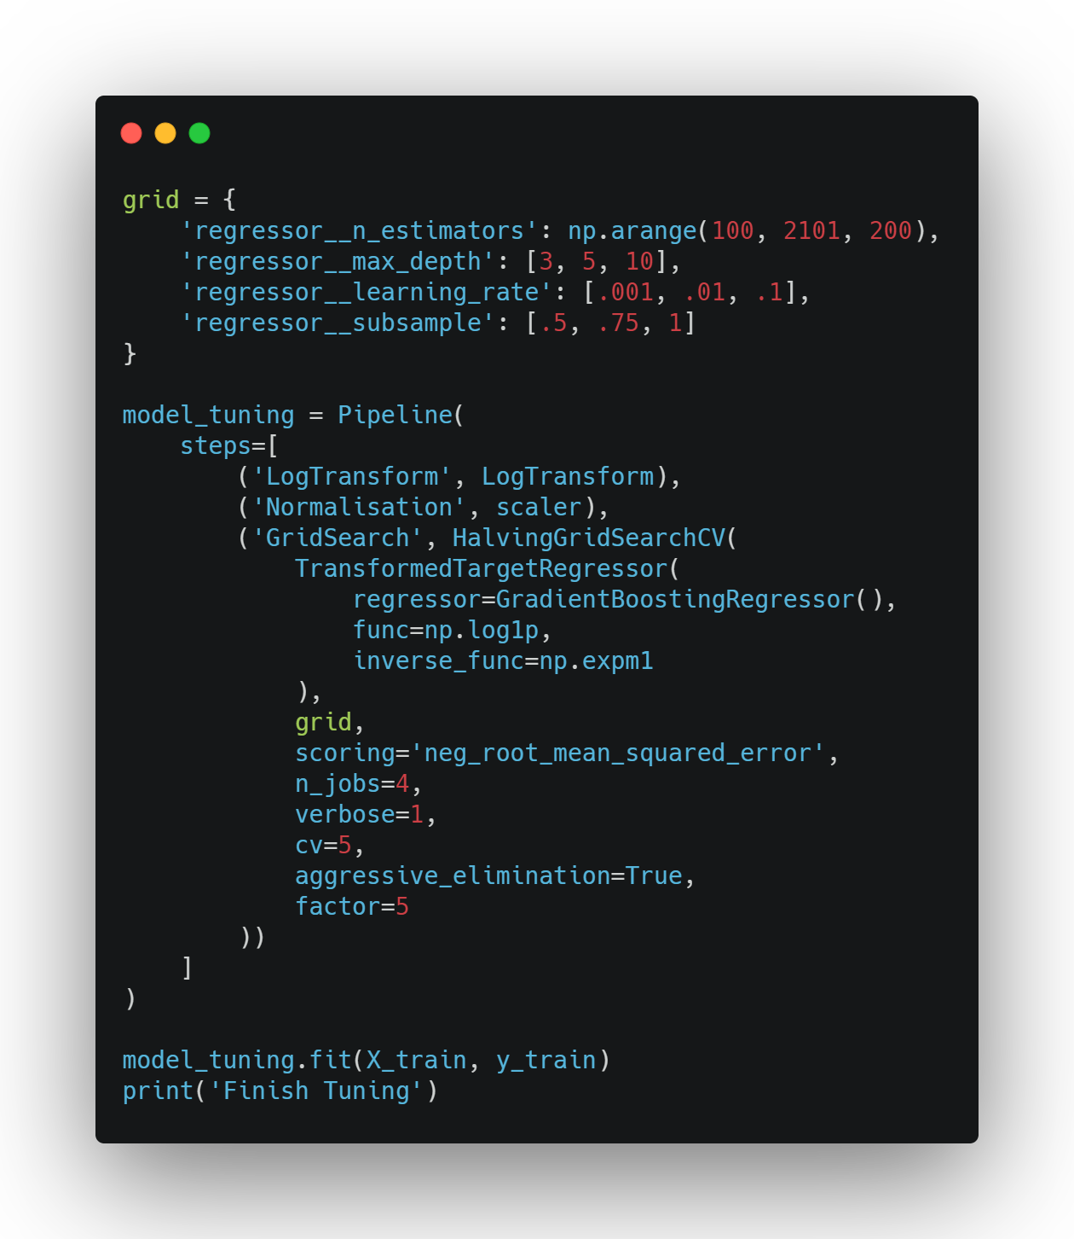
Hyperparameter Tuning – HalvingGridSearchCV

Slide 58
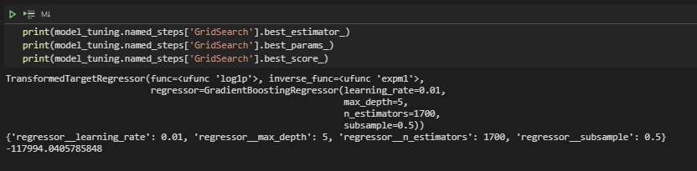
Hyperparameter Tuning – HalvingGridSearchCV

Slide 59
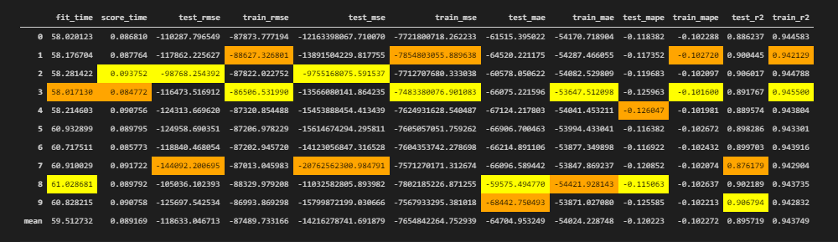
Hyperparameter Tuning – Cross Validation

Slide 60


Slide 61


Slide 62

Generating Predictions

Slide 63

Prediction Error Plot
Notes:
we can see the best fit line goes closer to the identiy line, meaning the model performance improved overall after hyperparameter tuning
it is hard to visualise, but there is lesser predicted outliers

Slide 64

Residual Plot
Notes:
Before Hyperparameter tuning, we can see that the predicted values are quite spread out all over the place, the histogram also indicate the same thing. Whereas after tuning, the points are more clustered together, the histogram shows the an increase in kurtosis smaller skewness.

Slide 65

Feature Importance

Slide 66
Conclusion
In conclusion, I would say the model fair well, with 112580 RMSE and 90.2% R-Squared. Seeing Lat, sqft_living15 and bathrooms are the most important features, it shows that location, house sizes and amenities do come into consideration when evaluating the price of the house.
One thing I would like to improve is implementing Geospatial Mapping using Geopandas to properly represent geographical coordinates.

